Slide 1



Research Masters in Economics
ECON22MA (2nd year ECON2MA)
ETRI2MA (1st year ETRI)

Slide 2
Economics School of Louvain
2 Sites : LLN – Namur
2 Schools of Excellence: ESL + ESN
20+12 Professors
4 Research centers: CORE / IRES / ETES / CRED
250 Post-Graduate Students
4 Masters : Research (2) / Professional / 1 year master
10 International Masters
1 Doctoral program
Notes:
ETES: Hover Chair of Economics and Social Ethics
CRED: NAMUR

Slide 3

ECON 22MA - Year 2/2 60 credits | ETRI21MA - Year 1/2 60 credits
Research Focus (30) | Research Focus (30)
Advanced courses in Economics (15) | Advanced courses in Economics (5)
--- | Quantitative Methods (10)
Master Thesis (15) | Essay Paper (15)
Notes:
Professional Focus (ECON2MS/G)
Research Focus (ECON2MA)
Econometrics Masters (ETRI)

Slide 4
ECON 22 MA
Research Focus – 5 courses + 1 seminar (30)
ECON2111 | Adv Microeconomics I (taken in Year 1 if you don’t have a direct access in the second year) | 5 | Q1
ECON2112 | Adv Microeconomics II | 5 | Q2
ECON2121 | Adv Macroeconomics I | 5 | Q1
ECON2122 | Adv Macroeconomics II | 5 | Q2
ECON2131 | Adv Econometrics | 5 | Q2
1 research seminar among ECON2161 Micro / ECON2653 Macro / ECON 2603 Econometrics |  | 5 | Q2
Advanced Economic Analysis I - 3 courses (15)
Master Thesis (15)
Notes:
The 120 ECON2M master has two focuses:
-Professional Focus (ECON2MS/G)
-Research Focus (ECON2MA)
Then there is the 120 Econometrics (ETRI2MA)
and the masert 60 ETRI2M1

Slide 5

ETRI2MA – 1st year
Research Focus – 5 courses + 1 seminar (30)
ECON2111 | Adv Micro I | 5 | Q1
ECON2112 | Adv Micro II | 5 | Q2
ECON2121 | Adv Macro I | 5 | Q1
ECON2122 | Adv Macro II | 5 | Q2
ECON2131 | Adv Econometrics | 5 | Q1
1 research seminar among 3 LECON2161 Micro / LECON2653 Macro / LECON 2603 Econometrics |  | 5 | Q2
Option Advanced Economic Analysis I – 1 course (5)
Quantitative Methods – 2 courses (10)
ECON2600 Dynamical Methods ECON2500 Math & Stat for Economists |  | 5 5 | Q1 Q1
Essay Paper (15)

Slide 6
ETRI2MA-2nd year
1 advanced course in econometrics (5)
ECON2601 | Adv Econometrics II – Time Series | 5 | Q2
ECON2602 | Adv Econometrics II – Microeconometrics | 5 | Q2
Option Advanced Economic Analysis I & II – 3 courses (15) Doctoral courses – 2 courses (only courses LECON27XX) (10) Research Seminars attendance (5)
Tutorial (Doctoral Workshop) (5) Thesis (20)
Notes:
We only have 2 doctoral courses this year, so instead f asking you 15 ECTS with doctoral courses, we only ask 10 ECTS with doctoral courses and 15 ECTS (i.e. 5 more) with the Option Advanced Economic Analysis

Slide 7
INFORMATION FOR ALL PROGRAMMES
  COURSE REGISTRATION
  submission of your programme form - for the whole year (Q1 & Q2) - by September 30th
  BOOT CAMP
  From 2/10 to 13/11
  Presentation on 22/09 13:00 13:45 MORE54 MANDATORY https://www.uclouvain.be/en/faculties/espo/esl/bootcamp-tools
  The evaluation of the Bootcamp will count for 1 point of your master thesis !
  THESIS & INFO SESSIONS
  From November 3rd to 13th

Slide 8
Thinking about PhD?
Admission to the Ph.D. program is granted conditional on:
graduating with a “distinction” = overall average of al least 14/20
[this is a necessary, but not sufficient condition];
submission to the Doctoral Commission and approval of application file.
The file must contain :
the name of the supervisor(s);
indication of the source of funding for the whole duration of the PhD;
a research proposal approved by the supervisor(s), i.e.
  title - context - state of the art - objectives - work plan – environment;
suggestion of supervisory panel;
a prospective doctoral training program, signed by the supervisor.
https://www.uclouvain.be/en/faculties/espo/esl/ph-d-esl 

Slide 9

EXAM REGULATIONS
2 exam sessions
Courses organised at 1st semester: January and September*
Courses organised at 2nd semester: June and September*
* The September session starts as early as August 13th.
WARNING: Each course can be evaluated twice per academic year ONLY if the mark obtained at the 1st evaluation is < 10/20
Passing conditions
10/20 (on each single exam, not on average)
Read carefully the exam regulations (RGEE)!
Check rules for international programmes (Double Degree / QEM)

Slide 10

MASTER THESIS PER PROGRAMME
ECON2MA
Year 2: Thesis submission
ETRI2MA
Year 1: Essay Paper submission
Year 2: Thesis submission
https://www.uclouvain.be/en/faculties/espo/esl/thesis

Slide 11

MASTER THESIS: The writing process?
Please attend the sessions
How to write a master thesis PART I (in November) and PART II (March)
A master thesis is intended as an original work of research
The work must contain a scientific approach, and the goal is to provide a rigorous analysis of an economic problem.
The work should contain:
the motivation
the literature review on the related topic
a theoretical or empirical analysis of the problem studied
the presentation of the results with regards to the research question

Slide 12

MASTER THESIS: The Schedule
 | Task | Agenda
Step 1 | Have a look at the research interests of ESL and UNamur professors | September – October
Step 2 | Thesis Forum Presentation of the research field of each ESL/ESN professor Personal discussions with professors | November 3th to November 13th (online sessions)
Step 3 | On-line submission of the Thesis Request | 1-year programs* - from November 23 to December 11 2-year programs** - from November 23 to March 26th (year 1) *1-year programs: ECON2MA (direct access), ECON2M1, ETRI2MA, Double Degree and QEM programmes ** 2-year programs: ECON2MS/G, ECON2MA (2 years)

Slide 13
MASTER THESIS: The Schedule
 | Task | Agenda
Step 4 | Approval of the topics and designation of the readers | 1-year programmes: by the end of February 2-year programmes: By the end of April
Step 5 | Writing of the thesis WARNING: an intermediate report must be submitted to the thesis Supervisor (by email) | February – June Interim report: BEFORE March 3rd / April 28th of the year of the thesis defense. For the 2-year programs and QEM students: submission by March 3rd For the 1-year programs: submission by April 28th
Step 6 | Submission of the thesis | Before the official opening of the exam session: either in June or in September
Step 7 | Oral defence | Either in the June session (only in June for QEM students and Maastricht DD) Or in the September session

Slide 14
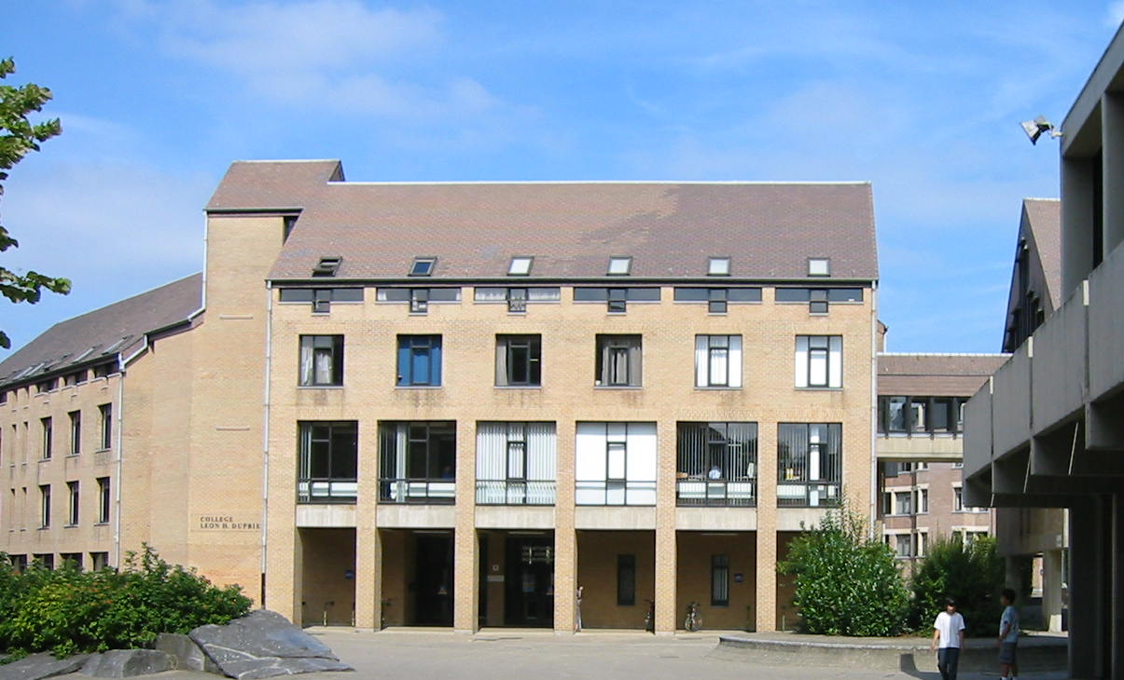
En savoir plus….
uclouvain.be/esl
Contact persons:
Laetitia Dablemont– School Manager - ESL- D.008
Laetitia.dablemont@uclouvain.be
Catherine Maréchal– International office – D.010
catherine.marechal@uclouvain.be
Julie Porreweck– Student Office– D.020
Julie.porreweck@uclouvain.be
Marine Bernard– Schedules – D.006
horaires-esl@uclouvain.be
UNamur: Nathan J’Espère
Nathan.jespere@unamur.be

