Slide 1



Masters in Economics
Professional (120) –ECON2MS/G
Research (120) – ECON21MA (1st year)
General (60) – ECON2M1
Welcome to ESL
September 2021 / QEM2 students

Slide 2
Economics School of Louvain
2 Sites : LLN – Namur
2 Schools of Excellence: ESL + ESN
20+12 Professors
4 Research centers: CORE / IRES / ETES / CRED
250 Post-Graduate Students
4 Masters : Research (2) / Professional / 1 year master
10 International masters
1 Doctoral program

Slide 3

ECON 2MS/G 120 Credits | ECON2M1 60 credits | ECON21MA 1st year
Core Course (10) Applied Econometrics Reflexive course |  | Core Course (15) Applied Econometrics Reflexive course Math&Stat for Econ
Professional Focus: (15) Using economic tools to solve global challenges (10 credits) SEMINAR (SACTU) (5 credits) |  | Research Focus (5) Adv. Micro I
Internship (15) + 3 Electives (15) Erasmus (30) | 3 Electives (15) | 1 elective (5)
3 Options (45) | 2 Options (30) | 2 Options (30)
Thesis (20) | Thesis (15) TFE Evaluation = !! 40% written part 60% oral defense | Thesis Part I (5) Summary of a scientific article

Slide 4
ECON 2 MS/G (Professional) – ECON2MA (1st year)
Econometrics– 1 course among 3 (5)
LECON2031 | Applied Econometrics: Time series | 5 | Q1
LECON2033 | Econométrie appliquée: Microéconométrie | 5 | Q1
ECONM826 | Applied Econometics (Namur) | 5 | Q1
TEACHING FOCUS
PROFESSIONAL FOCUS
CORE COURSES
1 reflexive course among 3 (5)
LECON2421 | Histoire du développement économique et social | 5 | Q1/Q3
LECON2061 | Philosophy and epistemology of economics | 5 | Q2/Q4
ECONM907 | Institutional Foundations of Market (Namur) | 5 | Q2/Q4

Slide 5

Professional Master ECON2MS/G (2)
MANDATORY FOR ALL STUDENTS IN ECON2MS/G (PROFESSIONAL FOCUS)
LECON2806 | Using economic tools to solve global challenges | 10 | Q1 & Q2
PROFESSIONAL FOCUS
MANDATORY
think of global issues and analyse data to address them
think formally about a problem and address it critically using data
Varied Teaching methods: will consist of lectures, tutorial sessions, small group presentations and in-class workshops.
Attendance and participation in all activities is mandatory

Slide 6
Professional Master ECON2MS/G (2)
1 Seminar of contemporary economic issues among 4 (5)
SACTU I | Le contenu est susceptible d'évoluer chaque année, en fonction de l'actualité. | 5 | Q2/Q4
SACTU II | Inflation, Inflation Expectations, and Central Bank Communication. | 5 | Q2/Q4
SACTU III | Le contenu est susceptible d'évoluer chaque année, en fonction de l'actualité. | 5 | Q1/Q3
SACTU IV | Le contenu est susceptible d'évoluer chaque année, en fonction de l'actualité. | 5 | Q1/Q3
Erasmus / International Exchange (30) OR
Internship (15) + 3 elective courses (15) among
 | Options of Specialization
 | Additional Courses in Economics (including Seminar of Economic Analysis SAE)
 | Quantitative Methods and Finance
 | Language Courses at UCLouvain
 | Language Courses at UNamur
3 options of specialization among 11 (45)
Thesis (20)
PROFESSIONAL FOCUS

Slide 7
Included in the electives ECON2MS/G
ELECTIVES: FOCUS ON THE SEMINARS
1 seminar of economic analysis among 4 (5)
SAE I | Digital Economy: EU Policies | 5 | Q1/Q3
SAE II | Economics of Inequality | 5 | Q2/Q4
SAE III | Applying Behavioral Insights in Practice - Nudges and RCTs | 5 | Q1/Q3
SAE IV | Gender Discrimination | 5 | Q2/Q4
PROFESSIONAL FOCUS

Slide 8
General Master (1year) – ECON2M1
1 YEAR MASTER
2 options of Specialization among 11 (30)
3 elective courses among (15)
 | Options of Specialization
 | Additional Courses in Economics (including Seminar of Economic Analysis SAE)
Travail de fin d’études (15) (oral defense 60% - written part 40%)

Slide 9
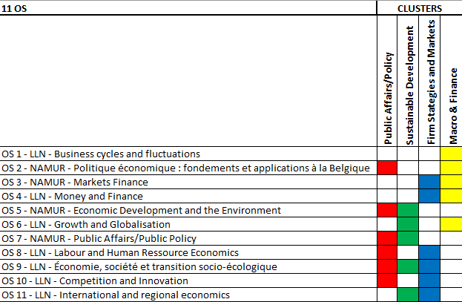
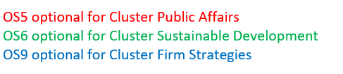
Options of Specialization
11 OS / 4 Clusters
4 Clusters to guide your option choices (free combinations)
Public Affairs/Policy
Sustainable Development
Firm Strategies and Markets
Macro & Finance
11 Options

Slide 10
Options of Specialization
11 OS / 4 Clusters
PUBLIC AFFAIRS
OS 2: Politique économique: fondements et applications (FR)
OS 5: Economic Development and the Environment (EN) (simultaneous to OS2)
OS 7: Public Affairs (EN)
OS 8 : Labour and Human Ressource Economics (EN)
OS 9 : Économie, Société et transition socio-écologique (FR/EN)
OS 10 : Competition and Innovation (EN)

Slide 11
Options of Specialization
11 OS / 4 Clusters
SUSTAINABLE DEVELOPMENT
OS 5: Economic Development and the Environment (EN)
OS 6: Growth and Globalisation (EN) (simultaneous to OS7)
OS 7: Public Affairs (EN)
OS 9 : Économie, Société et transition socio-écologique (FR/EN)
OS 11: International and Regional economics (EN)

Slide 12
Options of Specialization
11 OS / 4 Clusters
FIRM STRATEGIES AND MARKETS
OS 3: Finance:Markets (EN)
OS 4: Money and Finance (FR/EN)
OS 8 : Labour and Human Ressource Economics (EN)
OS 9 : Économie, Société et transition socio-écologique (FR/EN) (simultaneous to OS4)
OS 10 : Competition and Innovation (EN)

Slide 13
Options of Specialization
11 OS / 4 Clusters
MACRO AND FINANCE
OS 1: Business cycles and fluctuations (EN/FR)
OS 2: Politique économique: fondements et applications (FR)
OS 3: Finance: Markets (EN)
OS 4: Money and Finance (EN)
OS 6: Growth and Globalisation (EN)

Slide 14
Options of Specialization
Quadrimester & Site
11 options / 1 quadrimester / one side UCLouvain or UNamur
UCLouvain | Business cycles and fluctuations: drivers and policy responses | 15 | Q2/Q4
UNamur | Politique économique: fondements et applications | 15 | Q1/Q3
UNamur | Finance: Markets | 15 | Q2/Q4
UCLouvain | Money and Finance (FR/EN) | 15 | Q1/Q3
UNamur | Economic Development and the Environment | 15 | Q1/Q3
UCLouvain | Growth and Globalisation | 15 | Q2/Q4
UNamur | Public Affairs | 15 | Q2/Q4
UCLouvain | Labour and Human Ressource Economics | 15 | Q2/Q4
UCLouvain | Economie, société et transition socio-écologique | 15 | Q1/Q3 (Q2/Q4)
UCLouvain | Competition and Innovation | 15 | Q2/Q4
UCLouvain | International and Regional Economics | 15 | Q2/Q4

Slide 15

International
Professional & Research Master
ECON2MA
Exchange semester
Selection NOW
Mobility: 2nd semester 26-27
catherine.marechal@uclouvain.be
ECON2MS/G
Exchange semester
Info session: November 17th 2026
Selection: February 2027
Mobility: 1st semester 27-28
DOUBLE DEGREE (mobility in 27-28)
UNISTRA: ECON2MS/G
UNIMI: ECON2MS/G & ECON2MA
UNITO: ECON2MS/G
SGH*: ECON2MS/G & ECON2MA

Slide 16
ECON 2 MS/G (Professional)– ECON2MA (1st year)
Econometrics– 1 course among 3 (5)
LECON2031 | Applied Econometrics: Time series | 5 | Q1
LECON2033 | Econométrie appliquée: Microéconométrie | 5 | Q1
ECONM826 | Applied Econometics (Namur) | 5 | Q1
CORE COURSES
1 reflexive course among 3 (5)
LECON2421 | Histoire du développement économique et social | 5 | Q1/Q3
LECON2061 | Philosophy and epistemology of economics | 5 | Q2/Q4
ECONM907 | Institutional Foundations of Market (Namur) | 5 | Q2/Q4

Slide 17
ECON 2 MA (1st year Research)
1 Quantitative course (5)
LECON2500 | Mathematics and Statistics for Economics | 5 | Q1
1 course from the Research Focus (5)
LECON 2111 | Advanced Microeconomics I: Decision and Game Theory | 5 | Q1
1 reflexive course among 3 (5)
LECON2421 | Histoire du développement économique et social | 5 | Q2/Q4
LECON2061 | Philosophy and epistemology of economics | 5 | Q1/Q3
ECONM907 | Institutional Foundations of Market | 5 | Q2/Q4
RESEARCH FOCUS

Slide 18
ECON 21 MA (1st year Research)
2 options of Specialization among 11 (30)
1 elective courses among (5)
 | Options of Specialization
 | Additional Courses in Economics
Thesis Part 1 (5)

Slide 19
INFORMATION FOR ALL PROGRAMMES
  COURSE REGISTRATION
  submission of your programme form - for the whole year (Q1 & Q2) - by September 30th
  BOOT CAMP Mandatory for ALL new students : From 02/10 – 13/11
  Info session on 22/09/2026 13:00-13:45 MORE54
  The evaluation of the Booctamp will count for 1 point of your master thesis !

Slide 20

EXAM REGULATIONS
2 exam sessions
Courses organised at 1st semester: January and September*
Courses organised at 2nd semester: June and September*
* The September session starts as early as August 16th.
WARNING: Each course can be evaluated twice per academic year ONLY if the mark obtained at the 1st evaluation is < 10/20
Passing conditions
10/20 (on each single exam, not on average)
Read carefully the exam regulations (RGEE)!
Check rules for international programmes (Double Degree / QEM)

Slide 21

MASTER THESIS PER PROGRAMME
ECON2MA
Year 2: thesis submission
https://www.uclouvain.be/en/faculties/espo/esl/thesis

Slide 22

MASTER THESIS: The writing process?
Please attend the sessions
How to write a master thesis PART I (in November) and PART II (march)
A master thesis is intended as an original work of research
The work must contain a scientific approach and the goal is to provide a rigorous analysis of an economic problem.
The work should contain:
the motivation
the literature review on the related topic
a theoretical or empirical analysis of the problem studied
the presentation of the results with regards to the research question

Slide 23

MASTER THESIS: The Schedule
 | Task | Agenda
Step 1 | Give a look at the research interests of ESL and UNamur professors | September – October
Step 2 | Thesis Forum Presentation of the research field of each ESL/ESN professor Personal discussions with professors | November 3rd to November 13th (online sessions)
Step 3 | On-line submission of the Thesis Request | 1-year programmes* - from November 23 to December 11 2-year programmes** - from November 23 to March 26th (year 1) *1-year programmes: ECON2MA (direct access), ECON2M1, ETRI2MA, Double Degree and QEM programmes ** 2-year programmes: ECON2MS/G, ECON2MA (2 years)

Slide 24
MASTER THESIS: The Schedule
 | Task | Agenda
Step 4 | Approval of the topics and designation of the readers | 1-year programmes: by the end of February 2-year programmes: By the end of April
Step 5 | Writing of the thesis WARNING: an intermediate report must be submitted to the thesis Supervisor (by email) | February – June Interim report: BEFORE March 3rd / April 28th of the year of the thesis defense. For the 2-year programmes and QEM students: submission by March 3rd For the 1-year programmes: submission by April 28th
Step 6 | Submission of the thesis | Before the official opening of the exam session: either in June or in September
Step 7 | Oral defence | Either in the June session (only in June for QEM students and Maastricht DD) Or in the September session

Slide 25
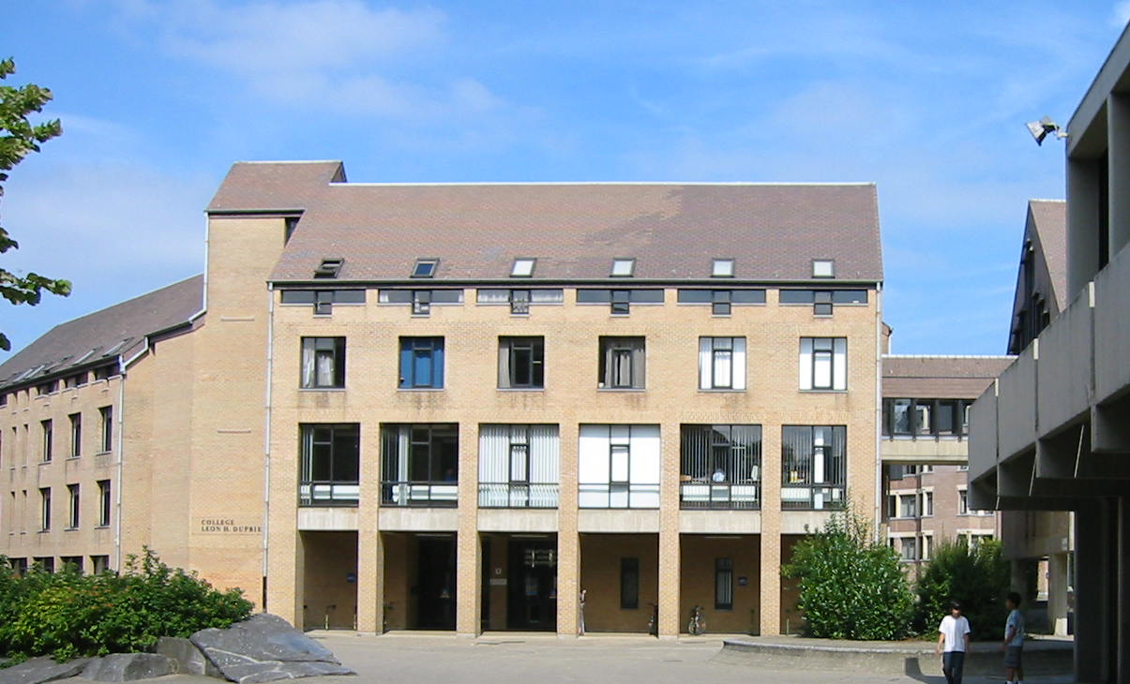
En savoir plus….
uclouvain.be/esl
Contact persons:
Laetitia Dablemont– School Manager - ESL- D.008
Laetitia.dablemont@uclouvain.be
Catherine Maréchal– International office – D.010
catherine.marechal@uclouvain.be
Julie Porreweck– Student Office– D.018
Julie.porreweck@uclouvain.be
Marine Bernard– Schedule Coordinator – D.006
Marine.bernard@uclouvain.be
UNamur: Nathan J’Espère
Nathan.jespere@unamur.be

