Slide 1


Monday 14/09/2026

Slide 2
In order to not delay the following information sessions, we will not take any questions.
Please read this PPT and go through our website first – You will find almost all your answers there ! ☺

Slide 3

The Administrative Team is here to help you !
Mrs. Laetitia Dablemont: School Manager & Internships
Laetitia.dablemont@uclouvain.be
D.008
Mrs. Julie Porreweck: Student Office Administrator
Julie.Porreweck@uclouvain.be
D.020
Mrs. Catherine Maréchal: International Affairs
Catherine.marechal@uclouvain.be
D.010
Mrs. Marine Bernard: School logistics & Schedules
horaires-esl@uclouvain.be
D.006
- Mr. Nathan J’Espère: Student Office UNamur
nathan.jespere@unamur.be
Room 520

Slide 4

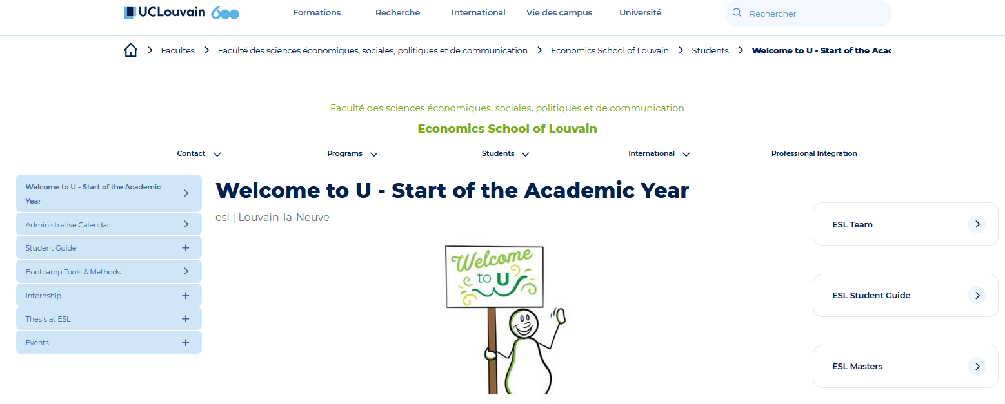
Our School’s website is where you will find all the information you need for your scholarship with us : https://www.uclouvain.be/en/faculties/espo/esl

Slide 5


TO DO LIST
Registration
Global User Account
My UCL
My Study/Mes études
Moodle
My Schedule
Examinations

Slide 6
TO DO LIST - REGISTRATION
Register at the University via the Registration Office by SEPT 30th at the latest
Where? Halles Universitaires, Place de l’Université, 1
Every registration or admission request has FIRST to go through an online request: https://www.uclouvain.be/fr/inscriptions/inscription-en-ligne

Slide 7
TO DO LIST – GLOBAL USER ACCOUNT
Take your student number: NOMA (you find it on the student card) and go to Compte UCLouvain

Slide 8
TO DO LIST – MY UCL
Get access to “My UCL” and manage your academic career via your widget “Mes études”
https://www.youtube.com/watch?v=i67bs9KsLOU

Slide 9
TO DO LIST – MY STUDY WIDGET
Register to the courses of your annual program via your “Mes etudes” widget of your MyUcl Dashboard
There you can also check your annual program once approved by the Jury (October)
You can also activate the Teams app and integrate Teams groups via the “My Study” widget

Slide 10
TO DO LIST – MOODLE WIDGET
Online platform on which professors post syllabus and course content, group work guidelines, send emails and interact via forums
Upload the Moodle Widget on your MyUcl dashboard
Register to your courses on the platform
!! Course registration on Moodle does not replace official course registration which is MANDATORY via “Mes études” widget !!

Slide 11
TO DO LIST – My Schedule WIDGET
Consult your schedule in REAL TIME via the “Schedule” widget of your MyUcl dahboard

Slide 12
TO DO LIST – EXAMINATIONS
For each course, the examinations are organized twice:
In January and September for the courses of Q1
In June and September for the courses of Q2
https://www.uclouvain.be/fr/universite/rgee
Registration to the examinations is automatic
You will have to validate or withdraw your registration to the examinations at specific dates fixed for each session via Mes études widget on your MyUcl Dashboard

Slide 13

Deadline to submit your PAE: 30th September

Slide 14
TO DO LIST – PAE – ECON2M1
TFE (Travail de fin d’Etude) LECON2950 – 15 ECTS : 40% for the written part and 60% for the oral defense
2 full Options of Specialization – 30 ECTS
3 elective course – 15 ECTS (or a 3rd full OS)
TOTAL = 60 ECTS

Slide 15
TO DO LIST – PAE- ECON2MS/G – YEAR 1
1 Econometrics Course (to be chosen among LECON2031, LECON2033, LECON2826) – 5 ECTS
LECON2806 Using Economic Tools to solve Global Challenges 10 ECTS (Mandatory course to be followed in Q1 & Q2)
3 Options of Specialization (to be chose among 11 available) – 45 ECTS
TOTAL = 60 ECTS

Slide 16
TO DO LIST – PAE- ECON2MS/G – YEAR 2
  1 Reflexive Course (to be chosen among LECON2421/2061/2907) – 5 ECTS
  1 ACTU Seminar (to be chosen among LECON2446/2373/2382/2820) – 5 ECTS
  Thesis LECON2910 – 20 ECTS
  30 ECTS to be completed with:
    1 Internship – 15 ECTS
    3 Elective courses (to be selected among the OS and Elective courses from the ECON2MS/G program; we recommend you select at least 1 Seminar Analysis Economic among the 4 available) – 15 ECTS
    OR
    1 Erasmus – 30 ECTS (upon selection)
  TOTAL = 60 ECTS

Slide 17
TO DO LIST – PAE – ECON2MA – YEAR 1
1 Econometrics course (to be chosen among LECON2031/2033/2826) – 5 ECTS
2 Options of Specialization – 30 ECTS
1 Course of Mathematics and Statistics for Economists – 5 ECTS
1 Elective course (to be chosen among the OS and electives courses from the ECON2MA program except Advanced Economic Analysis I) – 5 ECTS
TOTAL = 60 ECTS
Thesis First Part LECON2910A (Online activity to prepare the Thesis for year 2) – 5 ECTS
1 Reflexive Course (to be chosen among LECON2065/2067/2069)– 5 ECTS
1 Foundations in Economics course: LECON2111 Advanced Microeconomics I – 5 ECTS

Slide 18
TO DO LIST – PAE – ECON2MA – YEAR 2
  4 Foundations in Economic Courses – 20 ECTS
    LECON2121 Advanced Macroeconomics I: Intertemporal Behavior and Business Cycles
    LECON2122 Advanced Macroeconomics II: Growth, Dynamics and Policy
    LECON2112 Advanced Microeconomics II: game theory and information economics
    LECON2131 Advanced Econometrics
  1 Research Seminar to be chosen among LECON2161/2653/2603) - 5 ECTS
  4 elective courses to be chosen in the Advanced Economic Analysis I option – 20 ECTS
  Thesis LECON2910B – 15 ECTS
  TOTAL = 60 ECTS

Slide 19
TO DO LIST – PAE- ETRI2MA – YEAR 1
2 Quantitative Methods Courses: LECON2500 & LECON2600 – 10 ECTS
1 Research Seminar (to be chosen among LECON2161/2653/2603) – 5 ECTS
1 course to be chosen among options Advanced Economics I or Advanced Economics II – 5 ECTS
TOTAL = 60 ECTS
LECON2111 Advanced Microeconomics I
5 Foundations in Economic Courses – 25 ECTS
LECON2122 Advanced Macroeconomics II: Growth, Dynamics and Policy
LECON2112 Advanced Microeconomics II: game theory and information economics
LECON2131 Advanced Econometrics
LECON2121 Advanced Macroeconomics I: Intertemporal Behavior and Business Cycles
1 Essay Paper LETRI2800 – 15 ECTS

Slide 20
TO DO LIST – PAE- ETRI2MA – YEAR 2
1 Econometrics Course to be chosen among LECON2601 or 2602 – 5 ECTS
1 Research Seminar LECON2167 (participation in 20 seminars throughout the year) – 5 ECTS
3 courses to be chosen among options Advanced Economics I and Advanced Economics II – 15 ECTS
TOTAL = 60 ECTS
Thesis LETRI2900 – 20 ECTS
1 Workshop Tutorial LETRI2910 – 5 ECTS
2 Advanced Courses in Economics (LECON2702 & LECON2703) – 10 ECTS

Slide 21
Annual Program – PAE (Parcours Annuel de l’Etudiant)
Link to the annual programs:
https://uclouvain.be/prog-2026-econ2m1
https://uclouvain.be/en-prog-2026-econ2m-programme (for ECON2MS/G & ECON2MA - you just need to select your focus: Professional focus for ECON2MS/G and Research Focus for ECON2MA)
https://uclouvain.be/prog-2026-etri2m-programme
Once you have drafted your PAE on your side, you can go to OSIS and submit it online
1 ESL Ambassador Hugo Desmet will be at your disposal to answer your questions and help you create your PAE from 14/09 to 15/10 (see the schedule on ESL Website)
If the Ambassadors can’t help you, you can take an appointment with Mrs Porreweck for further guidance (!! If your questions do not require Mrs Porreweck’s assistance, you will be redirected to the student ambassador. This is to avoid long queue and excessive waiting times)

Slide 22


Meet your Ambassador
Hugo Desmet
He will be available in the Dupriez Building (meeting Room D.041 Floor 0) on the following dates :
Monday 14/09: 14.00 -17.00
Wednesday 16/09: 13.15 -16.15
Thursday 17/09: 13.15 -16.15
Tuesday 22/09: 10.00 -12.00
Wednesday 23/09: 12.00 -15.00
Tuesday 29/09: 10.00 -12.00
Wednesday 30/09: 12.00 -15.00
Tuesday 06/10: 10.00 -12.00
Wednesday 07/10: 12.00 -15.00
Tuesday 13/10: 10.00 -12.00
Wednesday15/10: 12.00 -15.00

Slide 23

ESL Administrative & Academic Calendar:
https://www.uclouvain.be/en/faculties/espo/esl/administrative-calendar

Slide 24
Important DATES - BOOTCAMP – 02/10 – 13/11
MANDATORY INFO SESSION: 22/09/2026 13:00-13:45 MORE54
6 modules of 3 hours (2hours theory and 1 hour practice)
Module 1: R introduction
Module 2: R advanced
Module 3: Scientific Writing using LaTeX
Module 4: Stata Introduction
Module 5: Stata Advanced
The Bootcamp will be evaluated after the 5 modules. This evaluation will count for 1 point out of 20 of your thesis
MANDATORY for ALL newcomers registered in an ESL master’s in Economics
Module 6: Soft Skills (how to speak in stressful situations and how to create impactful presentations?)

Slide 25

Important DATES – Thesis Administrative and Academic info session – Monday 02/11 13.00 to 14.00 AGOR10
Mandatory session
Thesis Calendar & more info on https://www.uclouvain.be/en/faculties/espo/esl/thesis
Theme : how and where to start writing my thesis?

Slide 26

Important DATES – Info Sessions Internship and International Exchanges – Tuesday 17/11
Mandatory session to explore the different possibilities that you have at your disposal
13h-14h MORE55

Slide 27
Important DATES – Thesis Forum – November 3rd to November 13th
(online activity)
Mandatory session
Online session
15 minutes presentation of the Research Fields of our ESL lecturers

Slide 28
Important DATES – Submission of the Thesis Topic and supervisor
1 year Program : November 23th to December 11th
2 years Programs: November 23th to March 26th

Slide 29
Important DATES – January session
04/01-23/01
Thesis Submission: 04/01
Thesis Defense: 25, 26 & 27/01
Online results: 01/02

Slide 30
Important DATES – FEBRUARY 2027
Internship CV Workshop Info session: 5/02: 12h45-13h30 LECL51
Application file Submission for Outgoing Exchange & DD Students: 8/02

Slide 31
Important DATES – MARCH 2027
Info session on How to Write a Master Thesis Part II: 9/03 13.00 to 14.00 AGOR10

Slide 32
Important DATES – June Session
June session: 31/05-26/06
Thesis submission: 31/05 (15/06 for QEM students only)
Thesis Defense Session: Unamur 21/06 - UCLouvain 22/06 – DD until 23/06 – QEM before 01/07
Online results 28/06

Slide 33
Important DATES – August Session
August session: 13/08-31/08
Thesis submission: 13/08
Thesis Defense: UCL 31/08 – Unamur 30/08 – DD until 01/09
Online results: 06/09

Slide 34
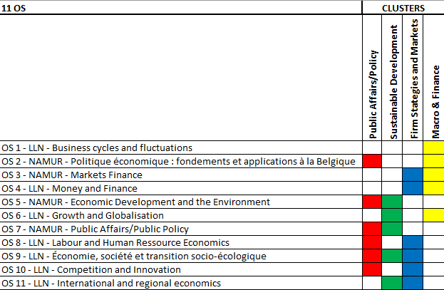
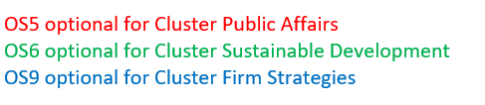
Options of Specialization
11 OS / 4 Clusters
11 options divided in 4 Clusters (free combinations)
1. Public Affairs/Policy
2. Sustainable Development
3. Firm Strategies and Markets
4. Macro & Finance
ECON2M1 : 3 full options or 2 full options + 3 courses elected in this list or in the elective courses list
ECON2MS/G : 3 full options + 3 elective courses
ECON2MA: 2 full options + 1 elective course

Slide 35

PUBLIC AFFAIRS
OS 2: Politique économique: fondements et applications (FR)
OS 5: Economic Development and the Environment (EN) (simultaneous to OS2)
OS 7: Public Affairs (EN)
OS 8 : Labour and Human Ressource Economics (EN)
OS 9 : Économie, Société et transition socio-écologique (FR/EN)
OS 10 : Competition and Innovation (EN)

Slide 36
SUSTAINABLE DEVELOPMENT
OS 5: Economic Development and the Environment (EN)
OS 6: Growth and Globalisation (EN) (simultaneous to OS7)
OS 7: Public Affairs (EN)
OS 9 : Économie, Société et transition socio-écologique (FR/EN)
OS 11: International and Regional economics (EN)

Slide 37
FIRM STRATEGIES AND MARKETS
OS 3: Finance:Markets (EN)
OS 4: Money and Finance (FR/EN)
OS 8 : Labour and Human Ressource Economics (EN)
OS 9 : Économie, Société et transition socio-écologique (FR/EN) (simultaneous to OS4)
OS 10 : Competition and Innovation (EN)

Slide 38
MACRO AND FINANCE
OS 1: Business cycles and fluctuations (EN/FR)
OS 2: Politique économique: fondements et applications (FR)
OS 3: Finance: Markets (EN)
OS 4: Money and Finance (EN)
OS 6: Growth and Globalisation (EN)

Slide 39

EXCHANGE & INTERNSHIP info session 17/11/2026
For ECON2MS/G: Info session →17/11
Selection: February 2026
For ECON2MA: Selection NOW and before 25/09– Departure second semester 26-27
Contact: international-espo@uclouvain.be
Other Opportunities:
Double Degree still available (DD destinations): UNISTRA, UNIMI, UNITO, SGH*
BIP Circle U: short-term mobility : Opportunities for students - Circle U.
Internship abroad: EU – Mobility Grant
Question about international opportunities: international-espo@uclouvain.be
Question about internships: stages-esl@uclouvain.be

Slide 40
