Slide 1
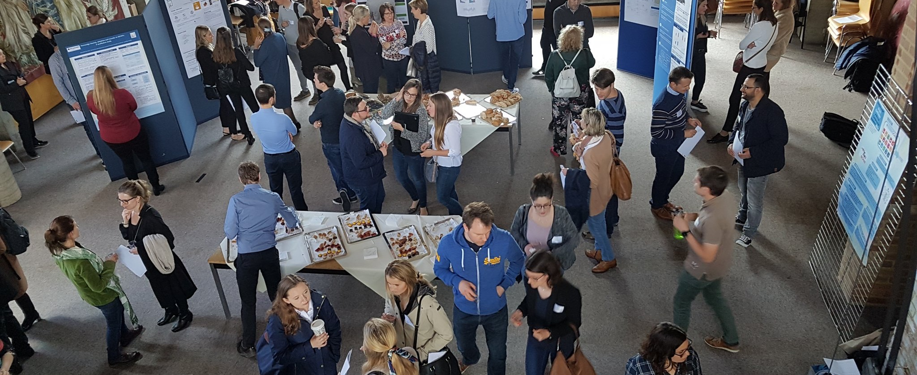
Doctoral School of Management PhD Program @ LSM
  CDD Economics and Management (CDE)
  Bureau Gestion
  Pr. Valérie Swaen

Slide 2

Agenda
Key bodies
Regulations
Doctoral program
Some figures
Key contacts

Slide 3

1. Key bodies

Slide 4
Key Bodies
CODOL
Doctoral Bureau in Management
UCLouvain Doctoral Committee: it drafts regulations, arbitrates disputes, chaired by the Pro-Rector for Research
Contact: doctorat-adre@uclouvain.be
It administers pre-admission, admission, confirmation, private and public defenses on a day-to-day basis and validates stages of students’ doctoral training
Contact: phd.lsm@uclouvain.be (Jennifer Van den Abbeele)
CDD Economics & Management
Doctoral School of Management
Doctoral Commission of the Domain: it supervises admission, confirmation & defense; resolves candidate/supervisor conflicts
It organizes doctoral courses and events; finances activities e.g. PhD Day
Website: https://www.doctoralschoolofmanagement.be/
Contact: laura.vecchiato@uclouvain.be or
secretariat-lourim@uclouvain.be
Reference: Doctoral Program in Management — Vademecum 2026-2027

Slide 5
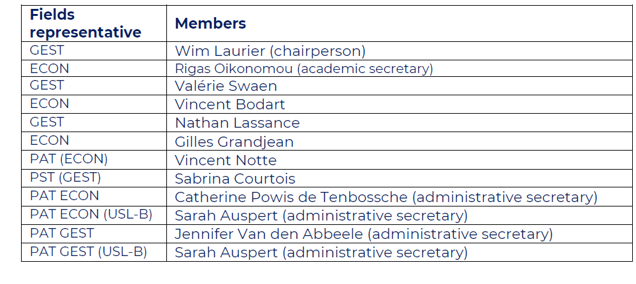
CDD Economics & Management
Doctoral Bureau in Management

Slide 6










Doctoral School of Management
“Joint EDT” UNamur – UCLouvain
CODOL
CDD - CDE
Ecoles Doctorales Thématiques
EDT
Doctoral School of Management
EDT
Doctoral School in Management Sciences
Doctoral training

Slide 7

2. Regulations

Slide 8
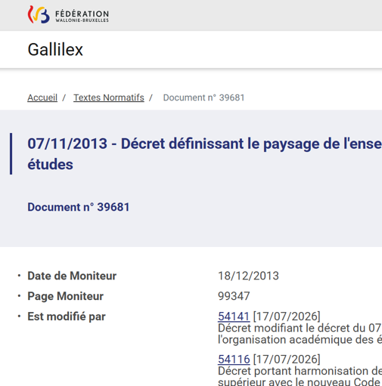
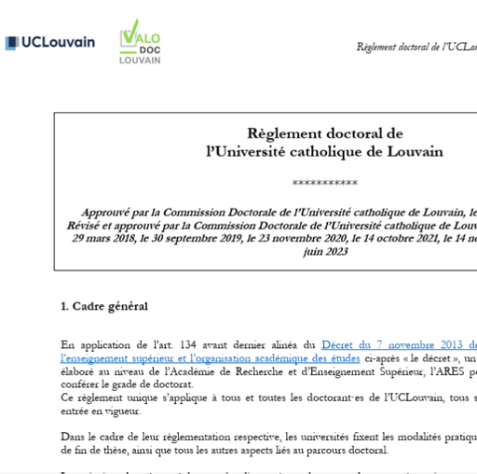
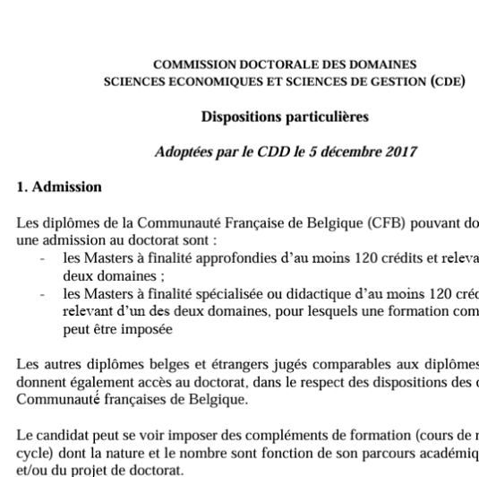
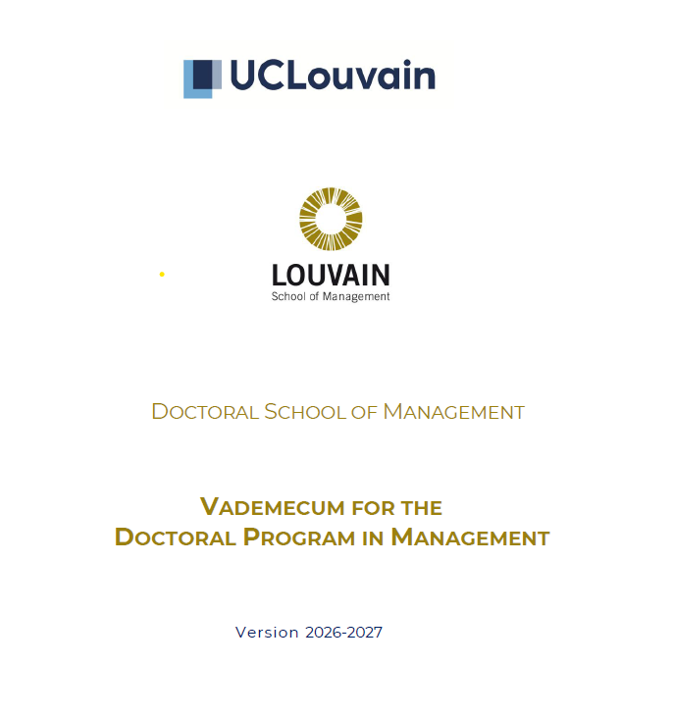

Regulations
Decree “Paysage et organisation des études ” (07/11/2013)
UCLouvain doctoral regulation
(29/03/2018)
Specific dispositions CDD Econ & Management - CDE (05/12/2017)
Vademecum 2026-2027 (soon)
REGISTRATION AT UCLOUVAIN
        NEW with OSIS: Once your admission file is submitted and accepted by the CDD, it is automatically transferred to SIC
        Contacts
          SIC LLN: inscription-lln@uclouvain.be
          SIC Mons: info-mons@uclouvain.be
        Warning: Yearly registration process until the defense

Slide 9

3. Doctoral program

Slide 10
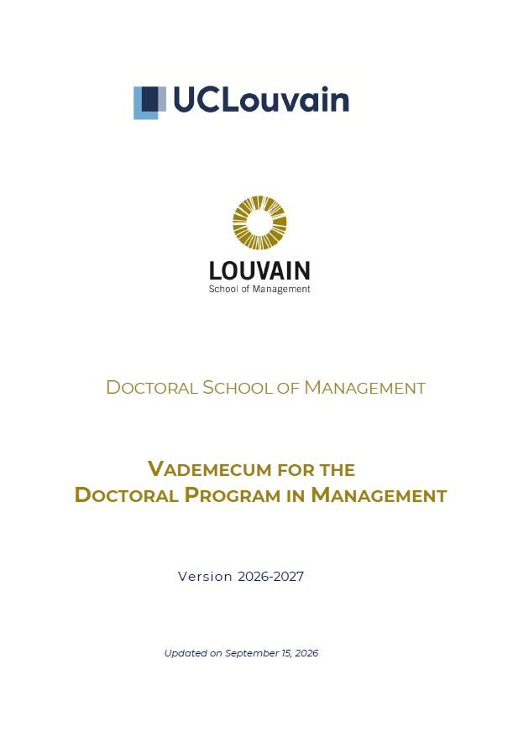
Vade mecum
Read in detail the vade mecum
New version will be published soon ;-) (mi-october 2026)
Reference: Doctoral Program in Management — Vademecum 2026-2027
https://uclouvain.be/en/faculties/lsm/doctoral-programmes

Slide 11

Program Overview
3-year programme worth 180 ECTS in total
Thesis (≥120 ECTS) + Research Training Programme (60 ECTS)
Open to holders of recognized Master’s degrees (at least 300 ECTS)
50 % of graduates go into academia
Tuition: 1194 € at definitive admission + 50 €/year administrative fee: teaching assistants and fellowship holders are exempt.
2
Reference: Doctoral Program in Management — Vademecum 2026-2027

Slide 12
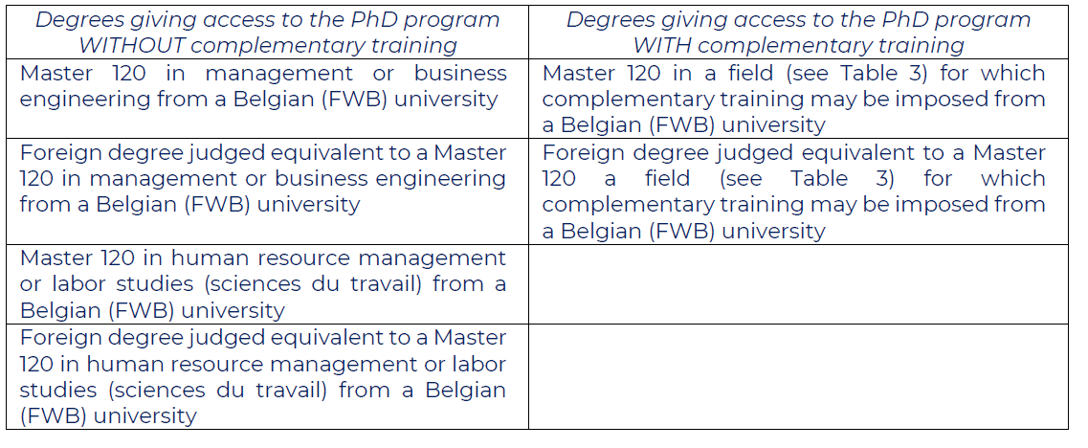
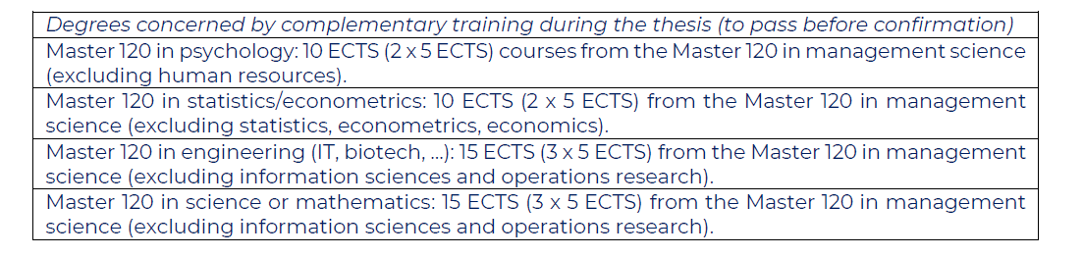
Academic Admission criteria
Very important slide for supervisors!!
Diplomas accepted obtained with “Honors” – min 70%
Complementary training during the thesis

Slide 13

Typical Doctoral process
1
2
3
4
5
Pre-Admission
Admission
Confirmation
Private Defense
Public Defense
CDD - CDE
Optional, max. 12 months, for visas & funding applications
Mandatory: supervisor, panel & registration confirmed
Within 24 months of admission
≤ 1 yr
≤ 2 yrs
≥ 1 yr
≤ 3 mth
4
Temp supervisor
Supervisor
Supervisory panel
Doctoral jury
Admission is required to undertake activities in the programme : no ECTS credit is awarded for work done before (pre-)admission.
Reference: Doctoral Program in Management — Vademecum 2026-2027

Slide 14


Admission Application
What's Needed
Identity documents, CV & degree certificates
Proof of Master's degree, obtained with Honors
English proficiency documentation
Signed Letter of Support from a permanent faculty supervisor
Research proposal (objectives, lit. review, methodology, bibliography, plan)
Supervisory panel proposal (≥2 members, ≥1 full-time UCLouvain professor)
Research training programme as a 4-year Gantt chart
Submission
Via the OSIS-Doctorat platform. Reviewed several times a year by the CDD.
Outcome sent to the candidate, supervisor(s), panel members & Enrolment Office.
6
Reference: Doctoral Program in Management — Vademecum 2026-2027

Slide 15
The research proposal
The research proposal is a document edited in English or French using the specific form with the following contents:
  Tentative thesis title
  Summary of the objective or research questions for the project, including a statement of the motivation and originality of the chosen topic within the field of management.
  Short state-of-the-art literature review for recent work related to the proposed project.
  Methodological statement sufficiently detailed to enable an assessment of its relevance with respect to the stated research questions.
  Scientific bibliography
  Tentative project plan outlining human, material and financial resources necessary to complete the project.
Projects that are insufficiently specified, too ambitious or inadequate in terms of methodology or literature are rejected.

Slide 16
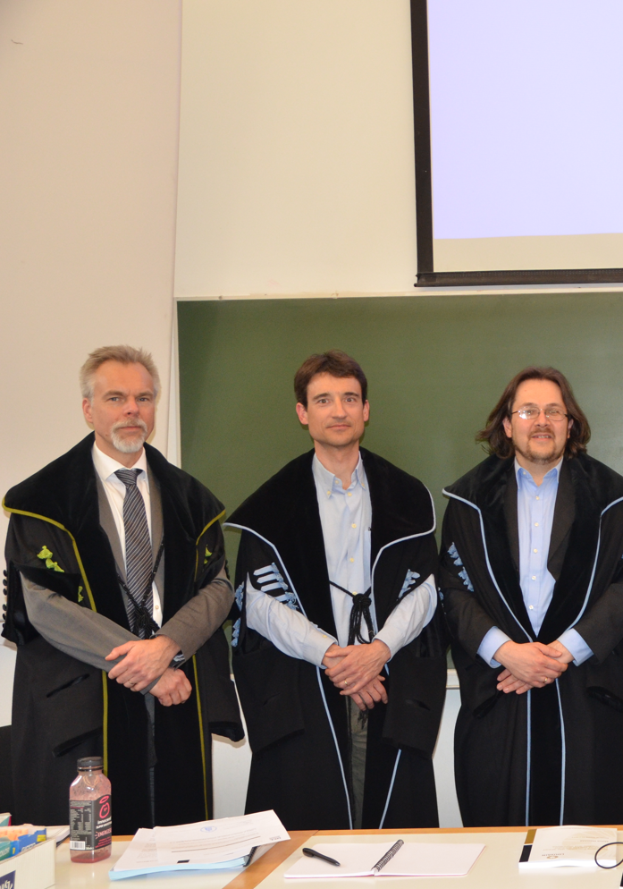
Supervisor & Supervisory Panel
S
The Supervisor
  Senior faculty member (professor or permanent scientist) holding a doctorate
  Co-supervision possible: at least one supervisor must be UCLouvain
  Must sign a Letter of Support confirming commitment to the project
P
The Panel
  At least 2 additional eligible members
  ≥1 internal full-time UCLouvain professor + ≥1 external to the research group
  Meets at least once a year with the candidate; completes an annual report
Doctoral Program in Management — Vademecum 2026-2027
7

Slide 17
Confirmation Steps
1
2
3
4
5
CDD - CDE
Pre-Admission
Admission
Confirmation
Private Defense
Public Defense
Mandatory for renewal of your FNRS/FSR fellowship and your 2nd Teaching Assistant contract !!
⚠️ Plan ahead: the renewal decision is made at least 6 months before your contract/fellowship ends
If you fail, the CDD may allow one retry, within 12 months.
Optional, max. 12 months, for visas & funding applications
Mandatory: supervisor, panel & registration confirmed
Within 24 months of admission
MAX. 24 months
≤ 1 yr
≤ 2 yrs
≥ 1 yr
≤ 3 mth
deadline from definitive admission
Temp supervisor
Supervisor
Supervisory panel
Doctoral jury
1
2
3
4
5
Log confirmation date in the Virtual Office (≥1 month ahead)
Submit written report / article(s) via OSIS (2 weeks ahead)
20-minute oral presentation to the panel
Panel deliberates: pass / fail
Signed report uploaded to OSIS
Reference: Doctoral Program in Management — Vademecum 2026-2027
8

Slide 18
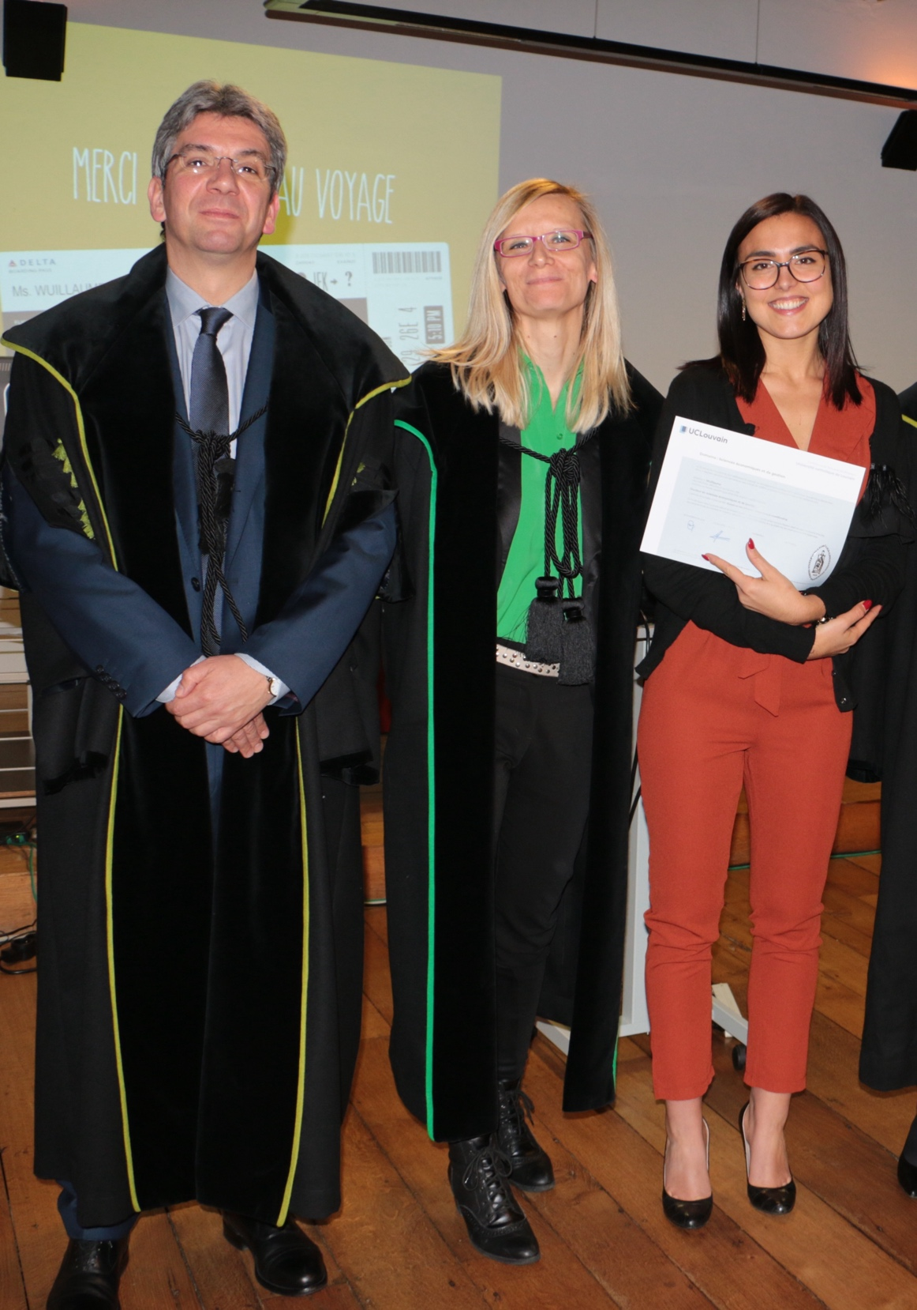
Doctoral Defense
Overview
Proposed by the supervisory panel once thesis & training are complete
Private defense possible earliest 1 year after confirmation
Chair must be UCLouvain academic staff (never the supervisor)
Jury composition
  ≥ 5 Members (incl. Chair & Secretary)
  Must include the research supervisor(s) and external examiners from outside the University.
≥ 5
Minimum 6 weeks required between jury appointment and the private defense.
9
Reference: Doctoral Program in Management — Vademecum 2026-2027

Slide 19
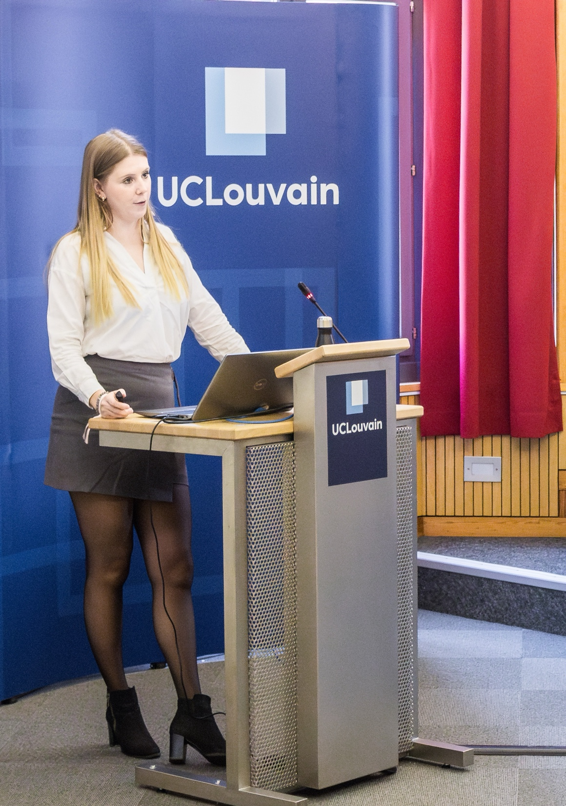
The Private Defense
Overview
1 month before
  Provisional thesis text sent to jury members
On the day
  30-minute oral presentation, then discussion with jury
Outcome
  Admissible / not admissible, with required modifications
Follow-up
  Up to 3 months to implement changes before public defense
Full jury attendance is required (videoconference allowed for unforeseen absences, with a written report submitted in advance)
10
Reference: Doctoral Program in Management — Vademecum 2026-2027

Slide 20
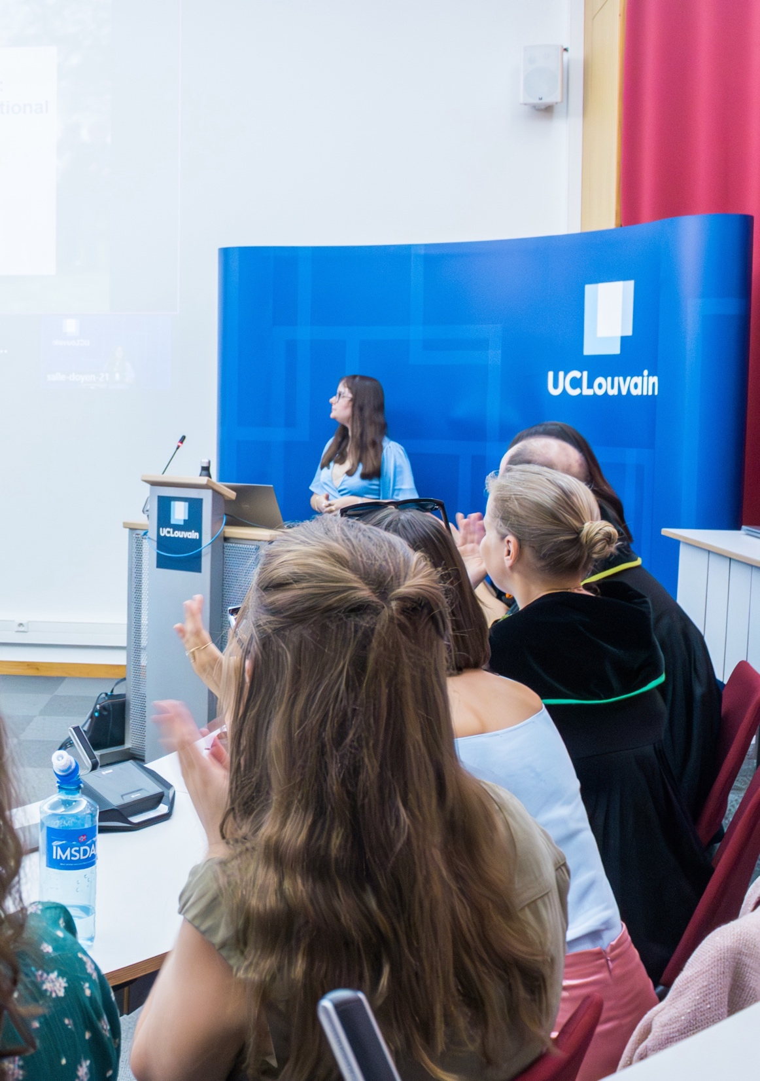
The Public Defense
Overview
Oral presentation of the research results, open to the public
  3hrs maximum duration
  ≥ 2/3 of jury must be present
Followed by discussion with the jury, then with attendees
Diploma & training certificate issued immediately after
Documents issued: Diploma · Official training certificate · Appendix with programme details · Official report & minutes of the public defense — all signed by Chair, Secretary, Candidate & Rector.
Doctoral Program in Management — Vademecum 2026-2027
11
Reference: Doctoral Program in Management — Vademecum 2026-2027

Slide 21

Jury Expenses
Extra costs beyond the cap: the supervisor must find additional funding (research contract, etc.)
Receipts (originals, all at once) must be sent within 3 months of the public defense date, or they won't be reimbursed
Send to CLC-LSM@uclouvain.be (Louvain-la-Neuve) or comptabilite-mons@uclouvain.be (Mons)
496 € reimbursement cap per PhD student for external jury members' travel & lodging (LSM Dean's office)
12
Reference: Doctoral Program in Management — Vademecum 2026-2027

Slide 22
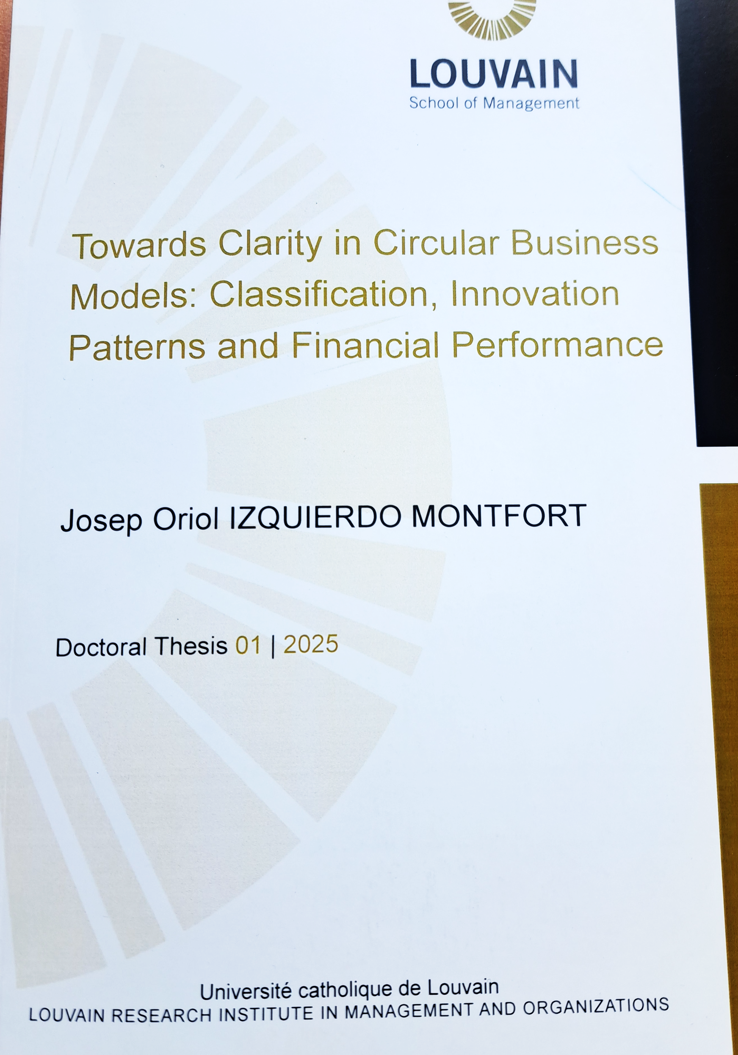
Thesis Formats
Monograph
A single coherent narrative: introduction, body chapters (literature, methodology, results), and conclusion, presenting and corroborating a central research hypothesis
Article-Based (≥ 3 articles)
General introduction linking the articles
Epistemological & methodological framing
General conclusion integrating all results
Co-author contribution certificate per article
Common requirements
≥1 article accepted, acceptable or considered as equivalent by the jury for publication in a journal ranked 1-3 (JUFO UNIFI) / Q1-Q3 (SJR)
3 working papers in a recognized collection
All articles presented/accepted at a recognized conference
13
Reference: Doctoral Program in Management — Vademecum 2026-2027

Slide 23

Your Doctoral training at UCLouvain from 2026-2027
In Admission application –
30 ECTS
Core courses, 18 ECTS
Seminars and reading groups ≥ 4 ECTS
Advanced courses
Confirmation 5 ECTS
Scientific communication and publication ≥ 13 ECTS (Max. 25 ECTS)
Specific case: cotutelle agreement
For candidates enrolled before 2026-2027 who have not yet completed all their mandatory course credits, a transition period is provided
Thesis work, 120 ECTS
including private and public defenses
Notes:
Mandatory courses cannot, under any circumstances, be substituted with electives courses.
This applies to all doctoral candidates without exception. However, in the case of a cotutelle agreement, some courses may not need to be taken at UCLouvain provided that an equivalent course at the partner university has been passed.
This doctoral programme applies to all doctoral PhD enrolled from the 2026–2027 academic year. For candidates enrolled before that academic year who have not yet completed all their mandatory course credits, a transition period is provided Please contact your local secretary so that your file can be reviewed by the CDD, which will then provide you a proposal.

Slide 24
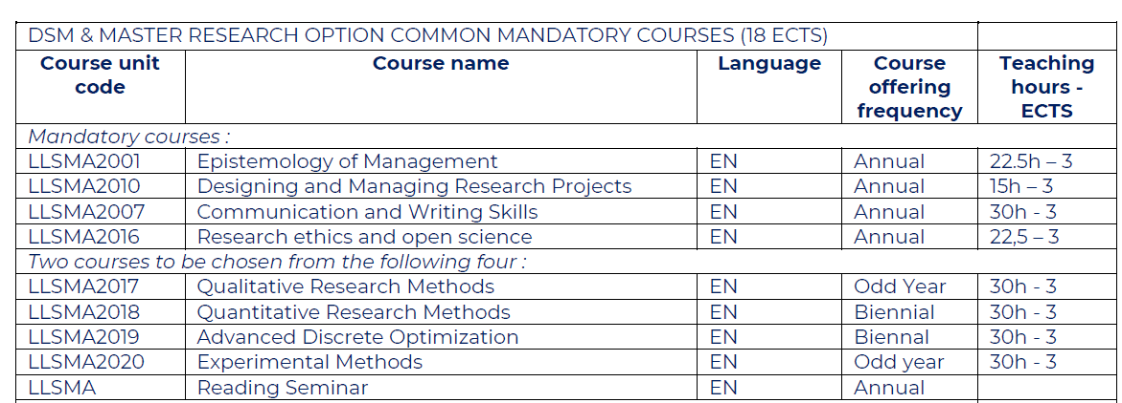
Core courses (18 ECTS)

Slide 25
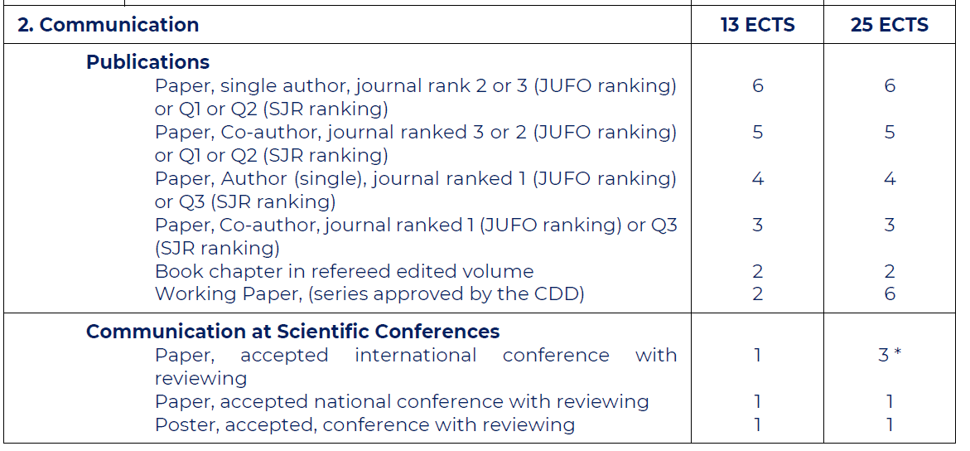
Communication

Slide 26
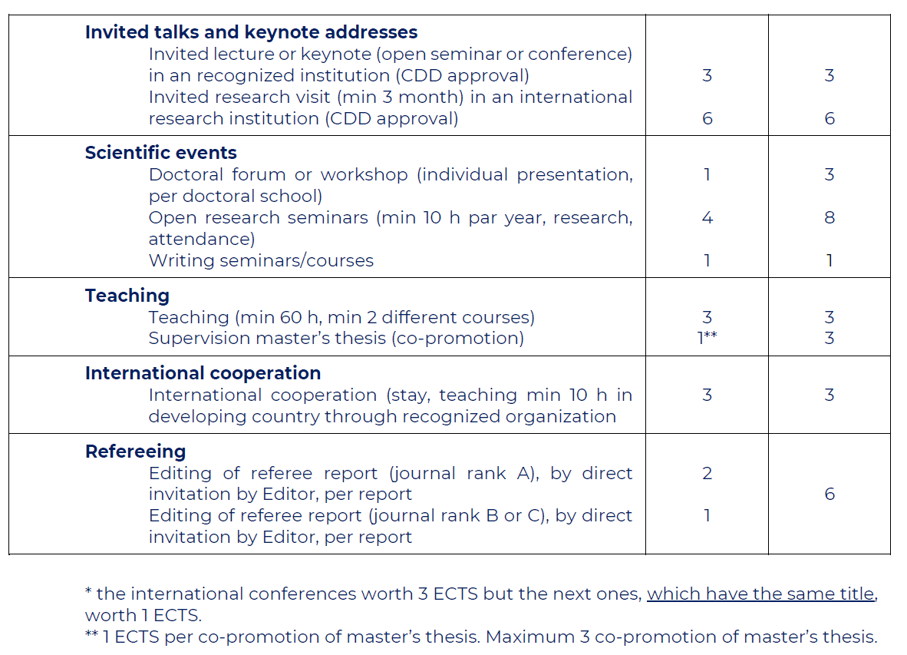
Communication (cont’)

Slide 27

Funding for Research Activities
FNRS Travel Support
  Covers airfare to international conferences. Apply 2 months ahead (3 for outside Europe)
FNRS Research Stays
  Funding for 1–3 month scientific stays abroad. Apply 2 months before the visit
CEMS Course Support
  Supplement to FNRS support for CEMS doctoral course participation
TA Operating Budget
  1500€ × 2, granted at the 1st and 2nd contract renewal
Project / chair Operating Budget
  Managed directly by the project or chair. Check terms with your supervisor
Note: most research funds are allocated to research institutes and/or supervisors; doctoral candidates generally cannot rely directly on university/faculty/department funding
16
Reference: Doctoral Program in Management — Vademecum 2026-2027

Slide 28








Research Entities
“Content Contributors”
UCLouvain’s Research Institutes
Unamur’s Research Institutes

Slide 29

4. Some figures

Slide 30

Some figures
December 2025: 85 PhD
  65 from UCLouvain (17 LIDAM, 41 LRIM, 3 IACCHOS, 1 IRIS-L)
  20 from UNamur
2025: 19 PhD defended
+/- 50% international PhD Students

Slide 31

Examples of positions
Project Officer (e.g., European Commission)
PostDoc (e.g, HEC Montréal, ULiège, ULB, Cambridge)
Assistant Professor (e.g., EDHEC, IESEG, HEC Liège, Toulouse BS, Solvay, UNamur, ICHEC, NEOMA BS, University of London, Edinburgh Business School, Copenhagen Business School)
Project Manager Positions in Higher Education Institutions
Founder SME
Senior Reporting Officer (e.g., FundRock LRI)
Economic Advisor (e.g., Banque Centrale du Luxembourg, OCDE, National Bank of Belgium/England/Moldavoa)
Invited Lecturer/Adj. Prof./Scientific collaborator (e.g., UCLouvain, ULB, UNamur, ULille, Uliège)

Slide 32

5. Key contacts

Slide 33
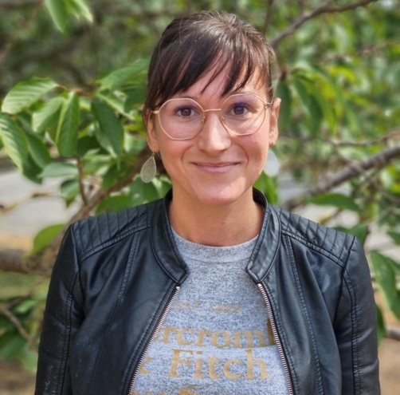
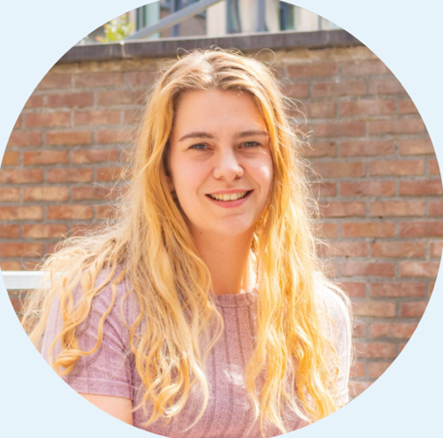
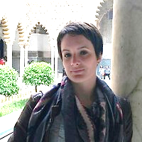

Key Contacts
Doctoral Bureau (during the PhD)
Doctoral Activities Coordinator (LouRIM/DSM)
CODOL general contact
Jennifer Van den Abbeele
Emilie Vilcot
phd.lsm@uclouvain.be
Laura Vecchiato
laura.vecchiato@uclouvain.be
doctorat-adre@uclouvain.be
Useful links:
OSIS-Doctorat platform
UCLouvain Doctoral Programmes page
EIASM
FRS-FNRS
17

